Slide 1
Sheffield
Renewables
AGM
10th Feb 2024
14:00 – 16:00

Slide 2
Agenda
Welcome and Introductions
Attendance and membership
Election of the Board
Resolutions
Chair’s Report
Operations Report
Treasurer's Report
Communications Report
Notes:
Welcome new company secretary

Slide 3
Attendance & Membership
Notes:
Welcome new company secretary

Slide 4
Members
240 last year
16 people withdrew all their shares last year
6 ex-volunteers have been taken-off the membership register
1 new volunteer member
Total members this year 219

Slide 5
Volunteers
Existing volunteers
Dave Berry – operations
Jean Tinsley – administrator
Richard Collins - Treasurer
Luke Wilson – project development
Keith Alford - member
Paul Cocker - member
Ted Datta – Communications Director
Erin Lachs – Chair
Nicolas Viphakone - project development
New volunteers
David Hayden – engineering
Ewan Norris – engineering / commercial
Jennifer Brown – commercial / legal

Slide 6
Directors
New directors
Sue Morton, longstanding investor member has stood for election
Directors Stepping Down and Standing for re-election
Secretary to report
Board role changes
N/A

Slide 7
Resolution A:
ELECTION OF THE BOARD
To approve election of directors for the year of 2024 as a true record.
Proposed by: Erin Lachs, Chair
Richard Collins, Erin Lachs, Luke Wilson, Keith Alford, Paul Cocker,
Ted Datta, Sue Morton

Slide 8
Resolution 1:
Minutes of the previous AGM
To approve the minutes of the 2023 Annual General Meeting as a true record.
Proposed by: Erin Lachs, Chair

Slide 9
Resolution 2:
Accounts for 2022 / 2023
To accept the draft accounts of the 2022/2023 financial year.
Proposed by: Richard Collins, Treasurer

Slide 10
Resolution 3:
AUDIT EXEMPTION
To approve an exemption from appointing an auditor for the 2022/2023 accounts,
under Rule 60.
Proposed by: Richard Collins, Treasurer

Slide 11
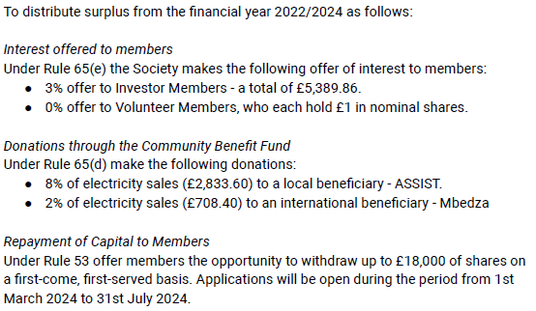
Resolution 4:
ALLOCATION OF SURPLUS
Proposed by: Richard Collins, Treasurer
To be agreed after Treasurer’s Report and CBF Explanation
- 80% of CBF to Assist
- 20% of CBF to Mbedza

Slide 12
Chair’s Report

Slide 13
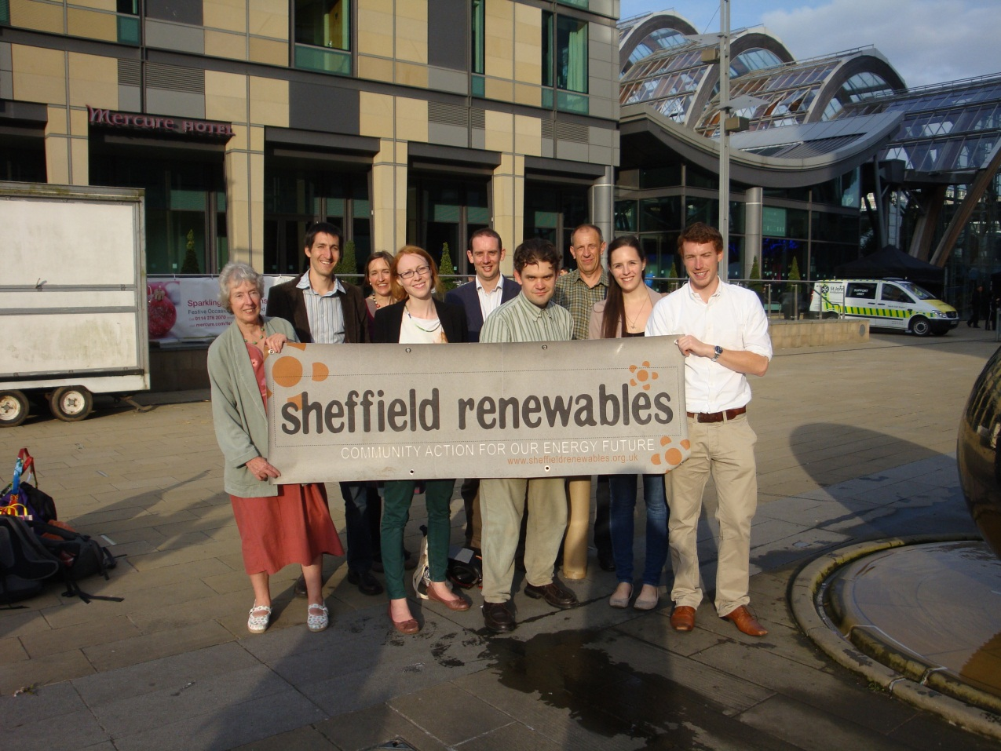
Sheffield Renewables
We are… a community and a social enterprise, that develops, funds, builds, owns and operates renewable energy schemes…
Run by and for local people…
Profits support local initiatives…
All about participation: involving local people as volunteers and investors…
Part of a growing movement of community energy projects across the country…

Slide 14
The News: Year in Summary
New Company Secretary – Lewis Blake Dagnall
New board meeting procedure and agenda
Successful year of generation
Higher yield than the original estimates
Over 1 300 000 kWh solar energy generated
(that’s nearly 400 households for a year!!!)
Completed Five Rivers 12kWp
Working on new projects

Slide 15
Events, Meetings and Funding
Community Energy
Regen: An introduction to planning for community renewables
Electricity Networks
ENA: West and South Yorkshire Decarbonisation Conference
NPG Transparency in Network Planning
Funding Opportunities
Northeast and Yorkshire Net Zero Hub
NPG Net Zero Community Energy Fund 2023

Slide 16
Potential New Projects
The Oakes 30kWp (ground-mounted)
Agreement in Principle
Planning pre-app advice received
Full planning application in preperation
Parkhill Flats 2x 25 kWp (+++)
Agreement in Principle
Design underway
Technical considerations & lease / PPA agreements

Slide 17
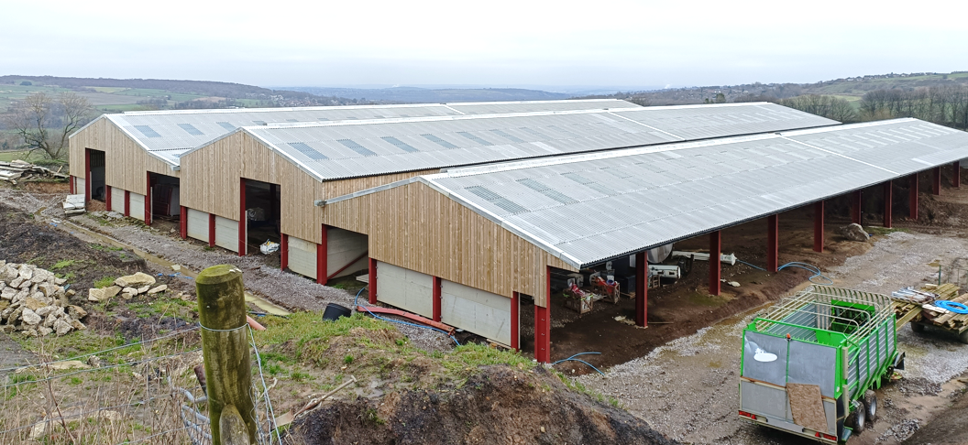
Project Pipeline
Tonco Bakery
NHS Trusts / GP Practices (Manor and Park Group GP Practice)
Schools pilot projects (x2)
Advanced Manufacturing Park
Church and dioceses buildings
Our Cow Molly

Slide 18
Further Project Potential
South Yorkshire Fire and Rescue - discontinued
Leisure Centres (e.g. SiV) – discontinued
Any ideas from members welcome!!

Slide 19
Volunteers & Directors
?
new !
?
?
?
This could be you !
new !
?
?
new !

Slide 20
Operations Report

Slide 21
Sheffield Renewables Operations
Over 1,302,432 kw/h (1.3 million) since start
2023 warmest year ever but lower irradiance
One breakdown at Lembas (inverter failure) – resolved under warranty
Five Rivers started generating!

Slide 22
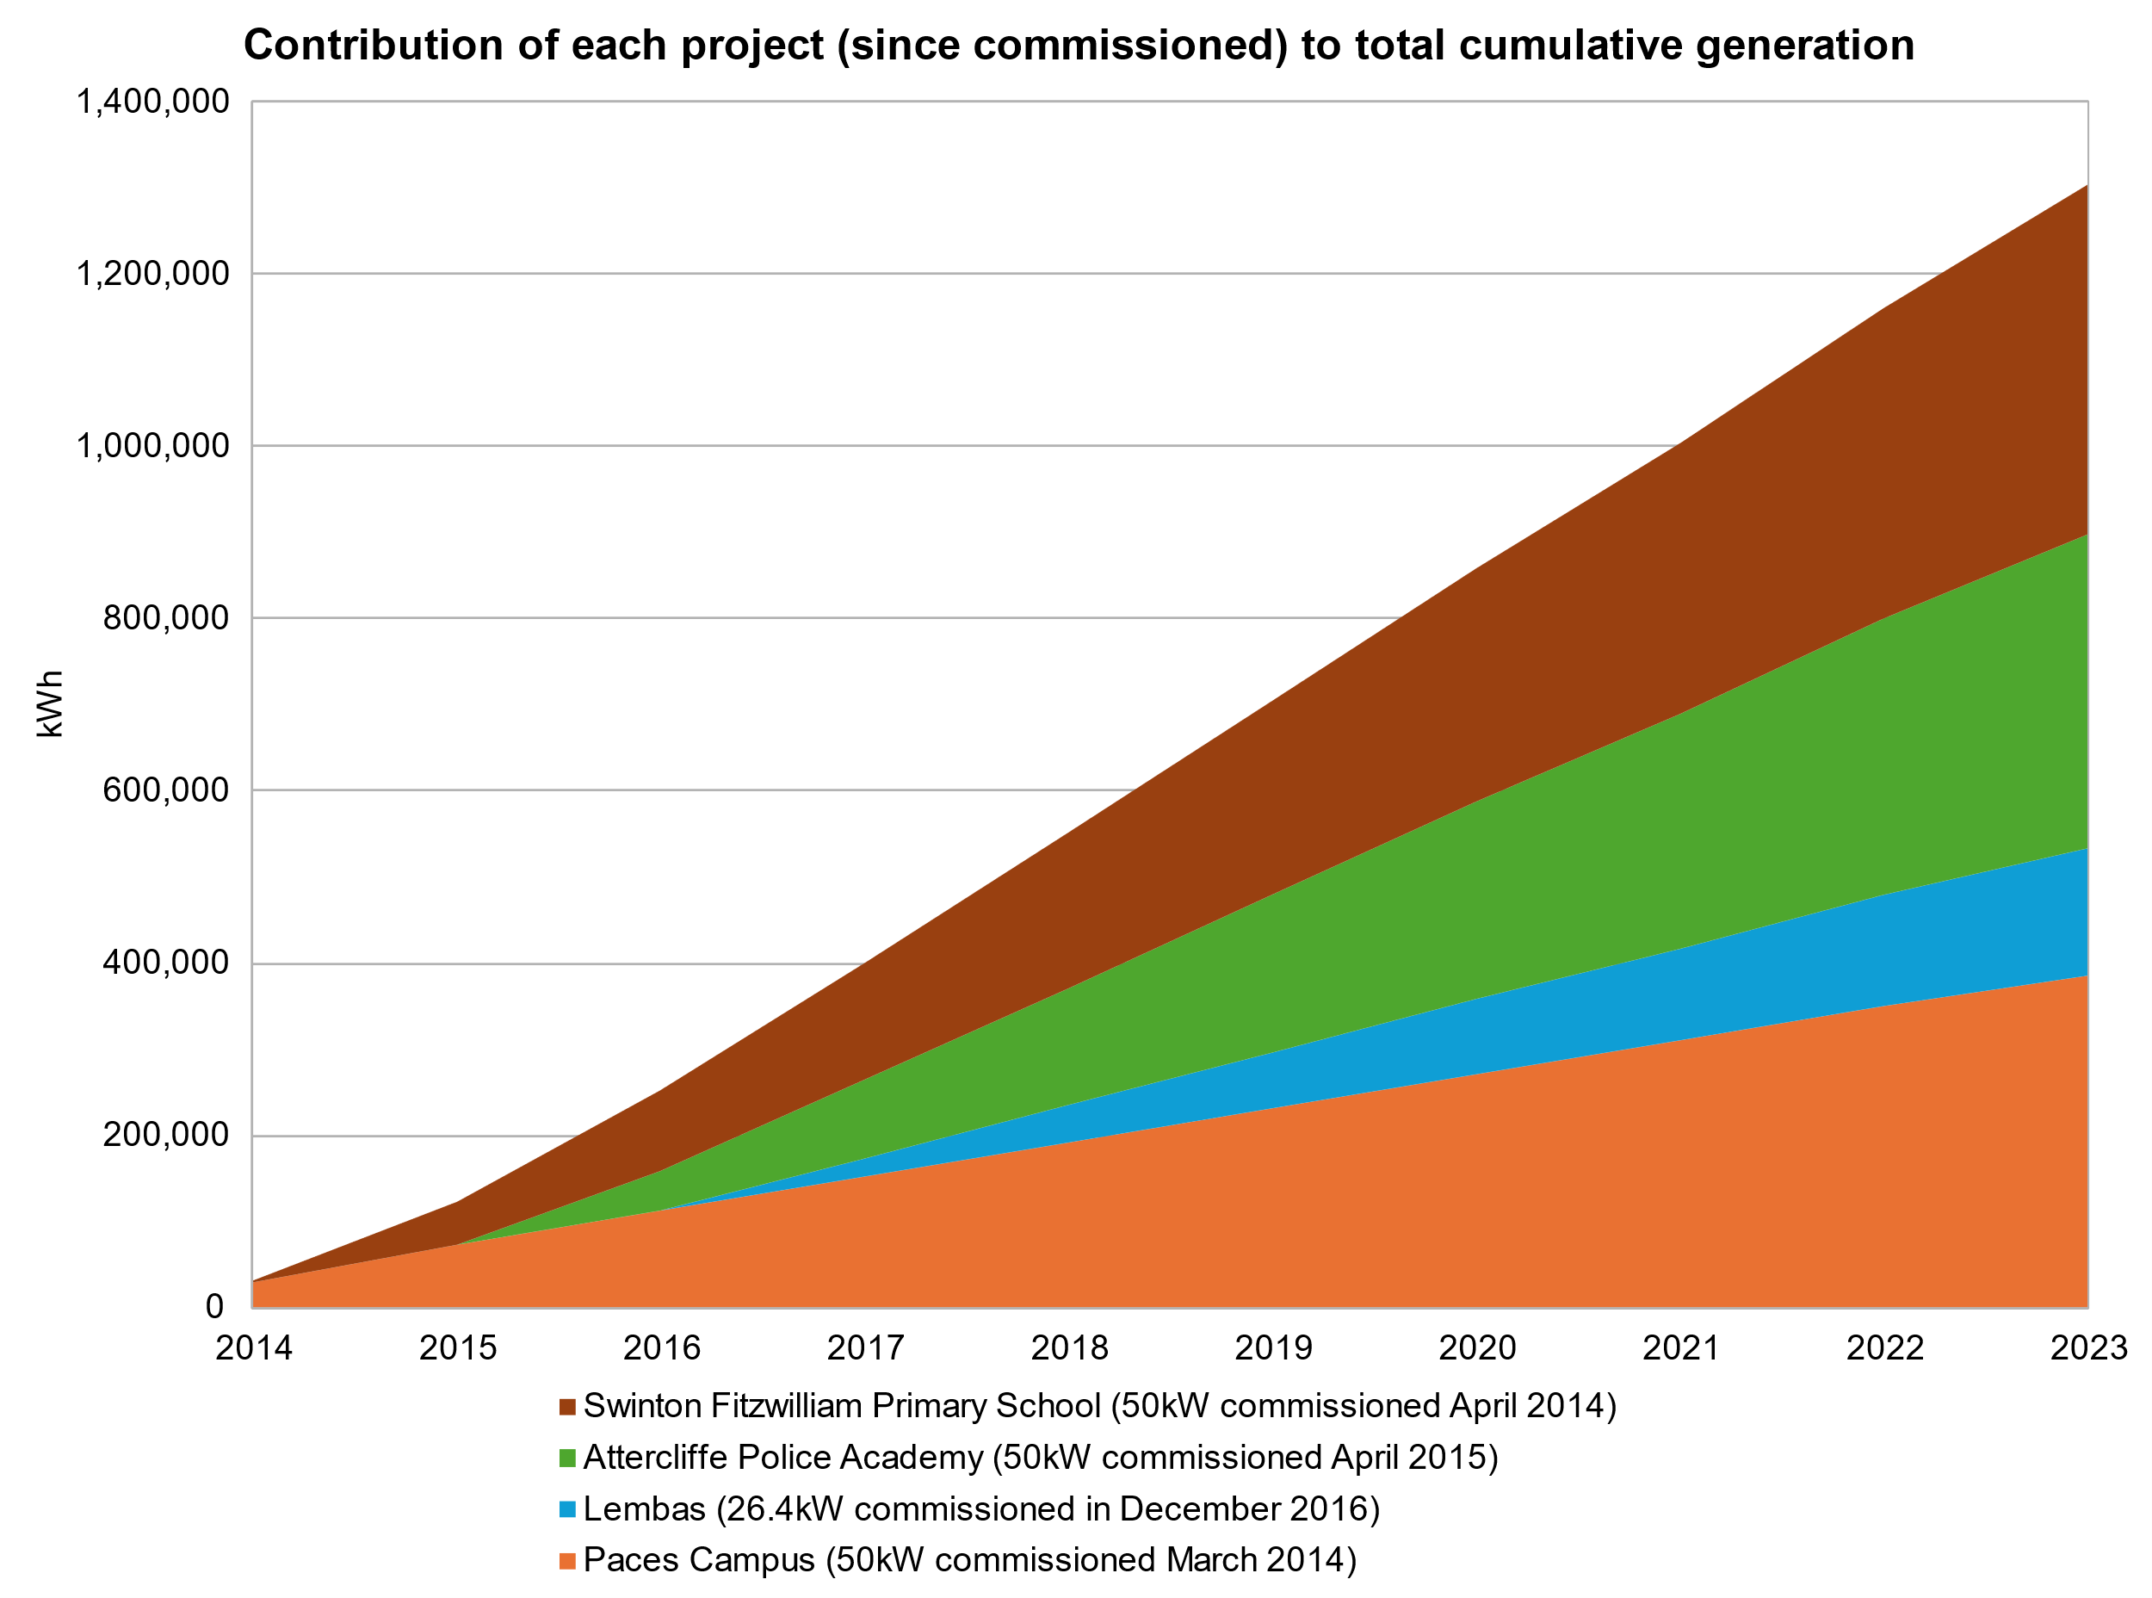
Sheffield Renewables Operations

Slide 23
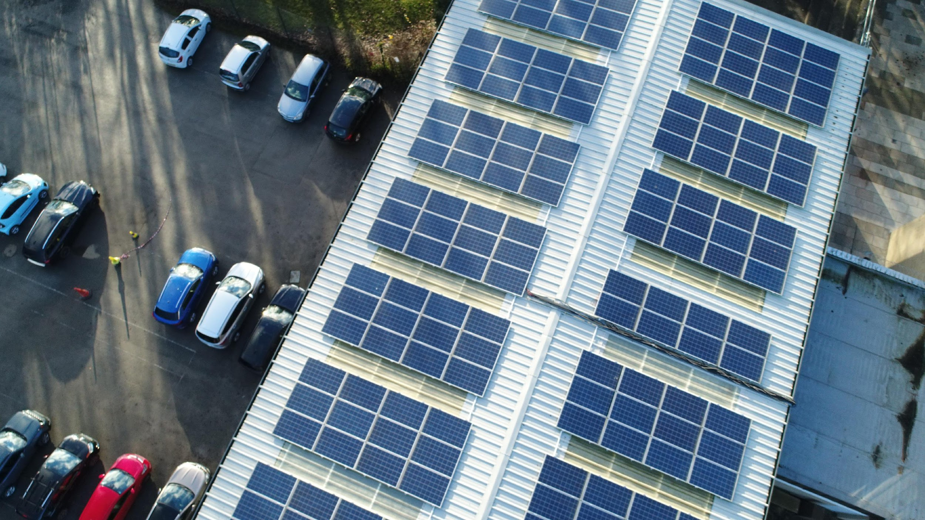
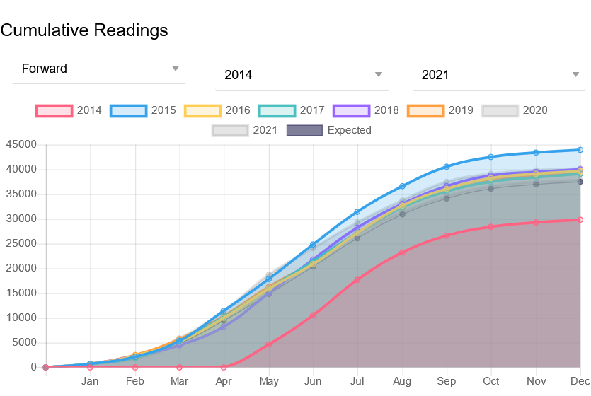
The Campus 50 kW
Installed May 2014
Total Production 386,022 kWh
Contract with SSE
Year | Production (kWh)
2014 | 29,889
2015 | 43,861
2016 | 39,629
2017 | 39,055
2018 | 40,078
2019 | 39,166
2020 | 40,279
2021 | 37,904
2022 | 39,946
2023 | 36,215

Slide 24
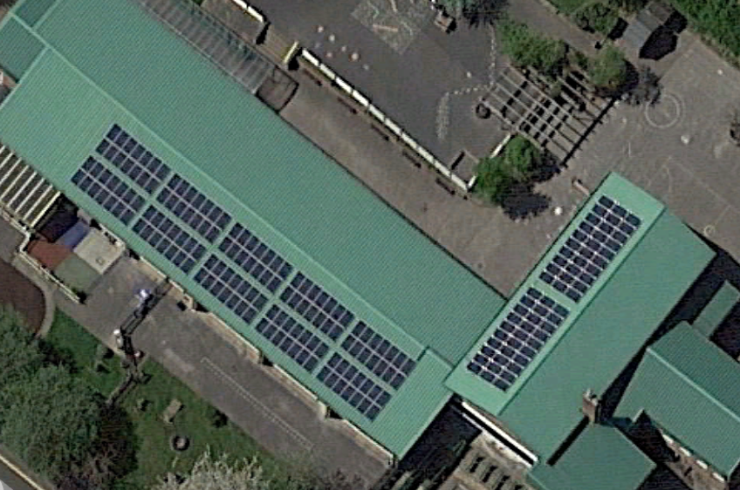
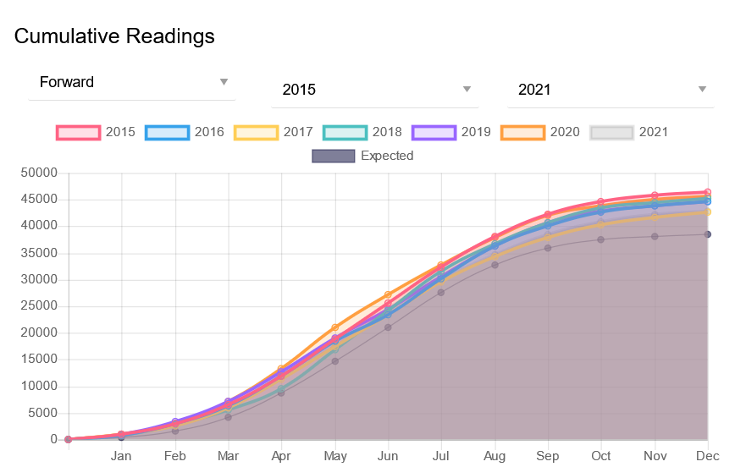
Swinton Primary School 50 kW
Installed November 2014
Total Production 360,957 kWh
Contract with Eon
New export meter fitted 2017
Total Export 133,966 kWh
Year | Production (kWh)
2014 | 2,050
2015 | 46,441
2016 | 44,639
2017 | 42,548
2018 | 45,263
2019 | 44,638
2020 | 45,698
2021 | 42,861
2022 | 46,818
2023 | 43,677

Slide 25
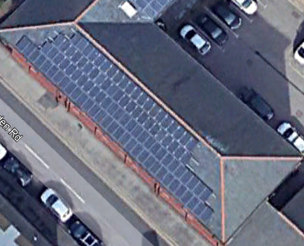
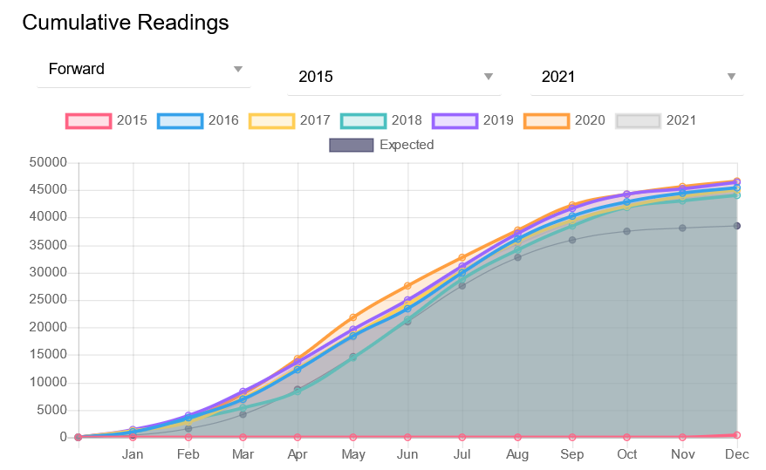
Attercliffe Police Academy 50 kW
Installed November 2015
Total production: 322,245 kWh
Contract with Eon
Year | Production (kWh)
2015 | 416
2016 | 45,560
2017 | 44,980
2018 | 44,084
2019 | 46,436
2020 | 46,571
2021 | 44,544
2022 | 48,004
2023 | 44,362

Slide 26
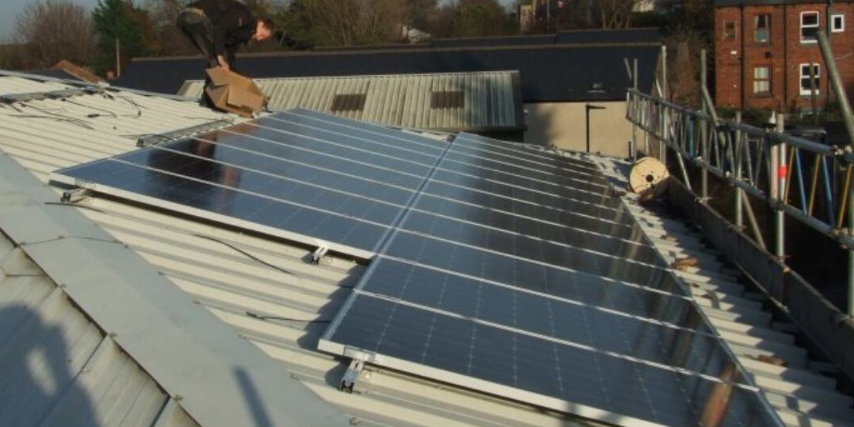
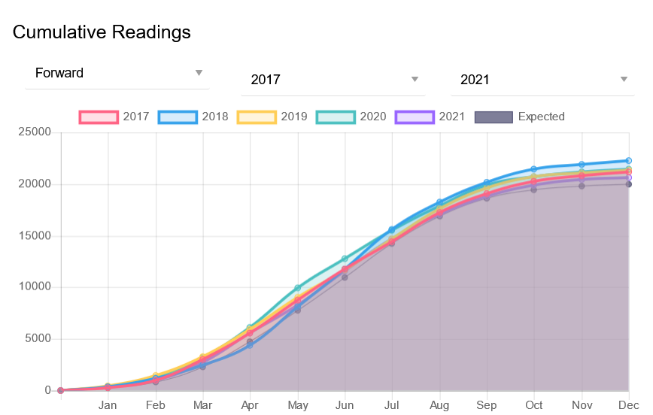
Lembas 26.4 kW
Installed Dec 2016
Total Production 129,177 kWh
Contract with Good Energy
Unmetered Export approx. 15%
Year | Production (kWh)
2017 | 21,411
2018 | 22,264
2019 | 21,360
2020 | 21,471
2021 | 20,669
2022 | 22,003
2023 | 17,643

Slide 27
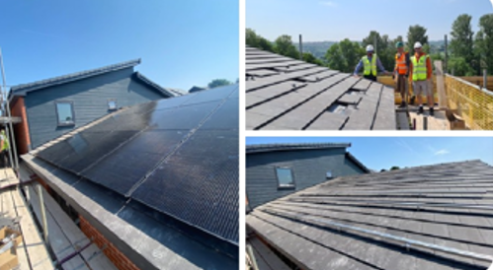
Five Rivers Co-housing, Wisewood 12.4 kW
Installed June 2023
Commissioned January 2024
No feed-in tariff but Smart Export Guarantee
415W large-aspect panels
Expected annual production expected 9,500kWh
Year | Production (kWh)
2024 | Tbc (expected 9,500)

Slide 28
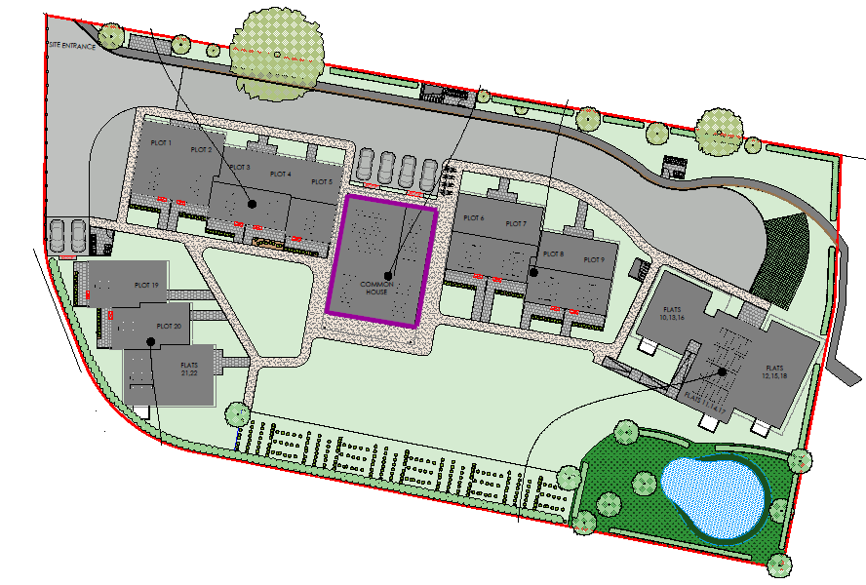
Five Rivers: Co-housing Project - North Sheffield
On Common House
Generation
12kWp scheme
Production 9,500 kWh
Usage
Communal kitchen
Laundry
Air Source Heat Pump
Timeline
Installation April/May
Operation July August

Slide 29
Treasurer’s Report

Slide 30
Organisation Finances Summary
Nearly £260k of revenue (electricity sales and fee income) since first scheme became operational
Total electricity generation now more than 955,000 kWh since first scheme became operational
Capital returned to investors to date: £66,571
Interest paid to investors: £30,491
Community Benefit Fund to date: £16,769

Slide 31
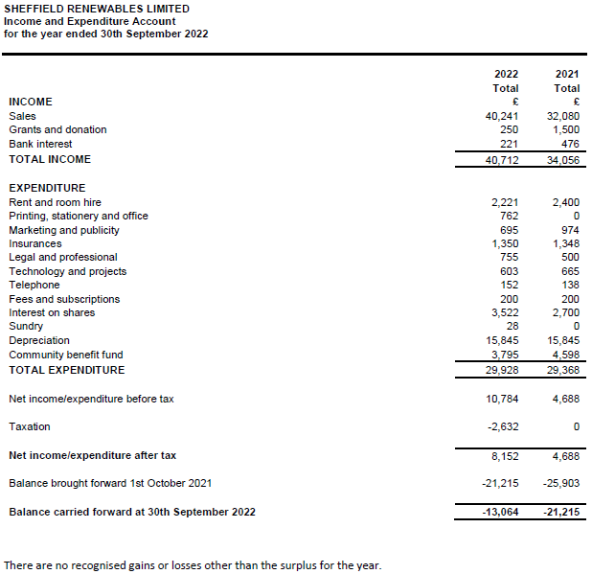
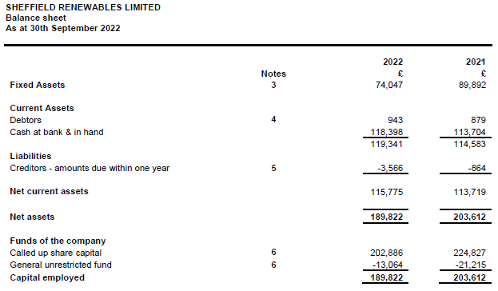
To agree the accounts and the audit exemption.

Slide 32
End of Year Allocation
Capital £201,267 (total)
Non-waived Capital £173,186 (£28,081 waived)
Capital Repayment
£24,764
Interest Payment
£5,195
Community Benefit Payment
£3,019
To agree the end of year figures.

Slide 33
Community Benefit Fund

Slide 34
Community Benefit Fund
The Community Benefit Fund (CBF) is designed to use a percentage of revenue (1.5%) to support organisations that have the same ethos as Sheffield Renewables.
We particularly wish to support projects that can achieve a social benefit whilst helping the environment, for example by addressing fuel poverty.
The decision for where to donate the CBF is down to the membership.
Each year we do a number of votes to decide where to donate the CBF.

Slide 35
Community Benefit 2022
Last year we allocated £ 3,019 to the CBF
Gleadless Valley Project: £ 2,415
Trine (Solar Investments): £ 604

Slide 36
Community Benefit 2022
Trine
2022
2023
Gleadless Valley Estate Project
With the grant from Sheffield Renewables GV Project set up a stall each Friday to inform residents about how to reduce energy bills and improve energy efficiency.
Displaying a selection of insulation materials, and wall posters publicising the availability of free materials and advice
The materials included draught proofing tape, radiator reflective insulation sheets, window film, LED bulbs, and door-bottom draught excluders.
For advice, we would discuss issues around keeping warm at home, including fuel poverty, poor insulation, and draughts, and provide free materials if suitable.
In November, we made contact with Green Doctor, an energy company funded support service providing free advice and insulation materials, and handed out leaflets with their contact details.

Slide 37
Proposed Organisations
for this year’s CBF
There have been no suggestions from the co-op members.
Sheffield Renewables Board proposes that the CBF is donated to the following organisations:
80% Local : Assist Energy Efficiency Measures - £2833
20% International : Mbedza: Malawi Tree Planting Project - £708

Slide 38
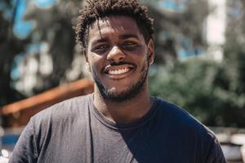
Assist Energy Efficiency Measures
Background
ASSIST was founded by people in Sheffield in 2003. ASSIST works primarily with
people seeking sanctuary who have had asylum applications refused and who are
therefore destitute, not able to work or study, and with no recourse to public funds.
(See ASSIST’s website: https://www.assistsheffield.org.uk/)
ASSIST’s work
ASSIST’s services last year included:
• client welfare payments - 105 people supported
• accommodation – housing 68 homeless people in shared houses and five
refugee families (with household utilities, cleaning materials and toiletries)
• advice, support and other welfare - 47 people helped to access legal support
• warmth - for those in our accommodation
This year, ASSIST is replacing its former night shelter with a new dispersed “Welcome House” scheme for new arrivals. Part of this work involves retrofitting our existing houses to raise all to EPC level C. We have received some Government grant money but need to match it with our own funds. Measures include insulation, solar panels and windows. This work is in partnership with SY Ecofit a new CIC, thereby also developing new skills and capacity within the city and bringing inward the investment.

Slide 39
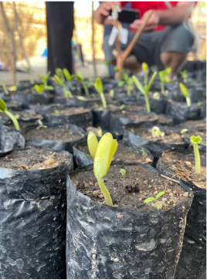
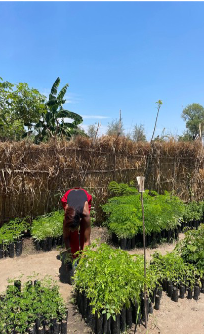
Mbedza Projects Support aims to deliver poverty reduction in Malawi through 4 key themes – livelihoods, health, environment, and education. Our environment and livelihood’s themes work closely together with a village intervention beginning with the building of Esperanza stoves for all households These stoves transform women’s lives by saving cooking and firewood collecting time and bring an end to burn injuries. The 60% reduction in firewood use has a very positive benefit on local environments where trees are in short supply.
Following the building of stoves we provide trees, grown in our own tree nurseries. These trees are provided for each household and for a village woodlot with the aim that after five years the village will have a sustainable source of wood supply. Mbedza provides support for five years with long term monitoring and training assisted by the Forestry Research Institute of Malawi.
We are looking for funding to develop our tree planting programme further and especially for our Green Match Fund campaign in April – funds donated towards this will be doubled by Big Give’s Corporate sponsors
These saplings are awaiting the arrival of the rains which come in December. This month, January 2024 our teams are at Machilka village
assisting the community in the planting out of their saplings in the village
woodlot and around households.
Seeds sown in August 2023 – 10 days growth, Machilka village,
Monkey Bay, Malawi.

Slide 40
Resolution 4:
ALLOCATION OF SURPLUS
Proposed by: Richard Collins, Treasurer
- 80% of CBF to Assist
- 20% of CBF to Mbedza

Slide 41
CBF: Suggestions for Next Year
We would like the beneficiaries of the CBF to reflect our members wishes
If you have any suggestions for next year please send us an email with details and why you think the organisation would be a great place to donate / invest the surplus

Slide 42
Communications Report

Slide 43
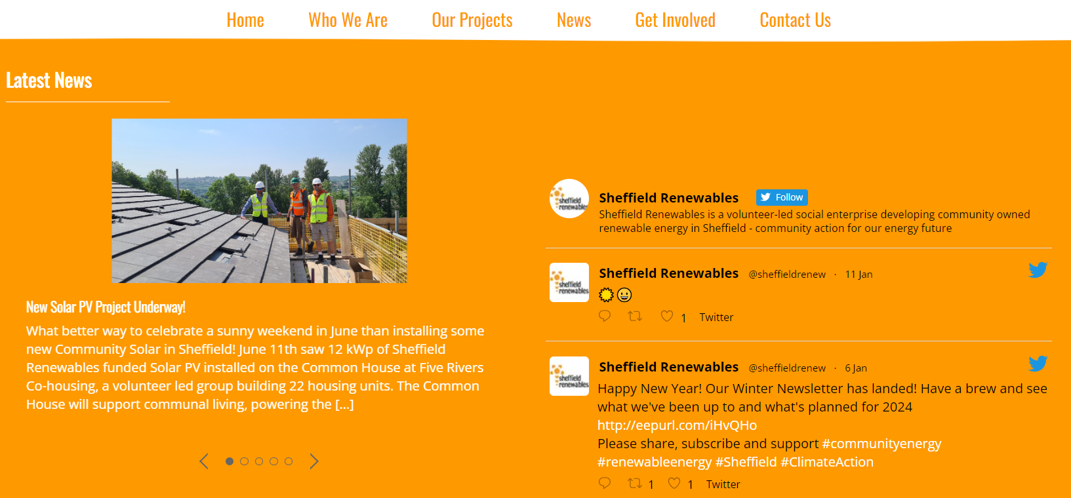
Sheffield Renewables Comms
1000 Newsletter subscribers (2 per year) – Summer & Winter
3000 twitter followers @sheffieldrenew
1000 facebook followers
114 (and growing!!) LinkedIn followers
WhatsApp group for volunteers
Website “news” refresh

Slide 44
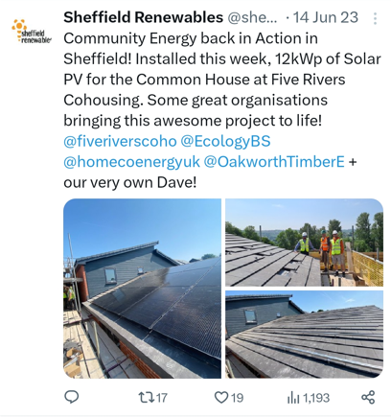
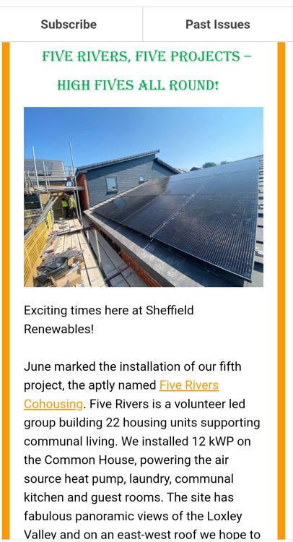
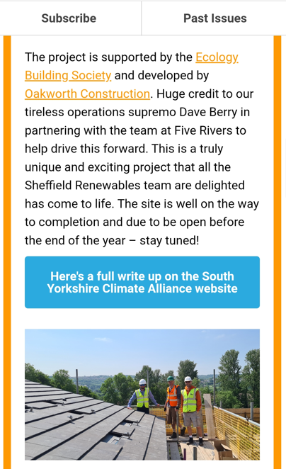
Summer Newsletter
Summer Newsletter – great engagement!
Delivered to 957 (August)
Opened by 280 (34%)

Slide 45
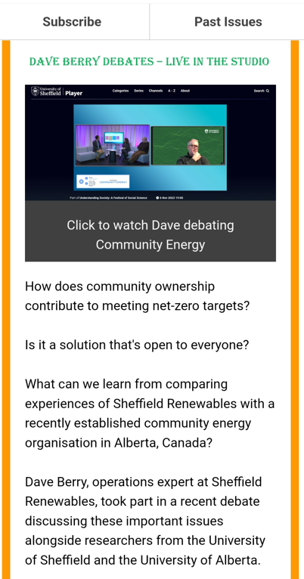
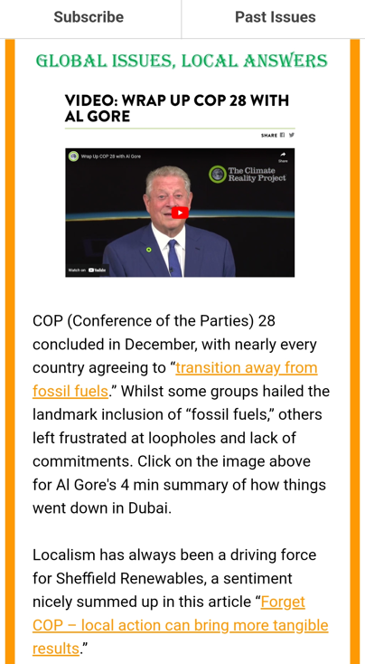
Winter Newsletter
Winter Newsletter
Delivered to 941 (Jan)
Opened by 230 (28.5%)

Slide 46
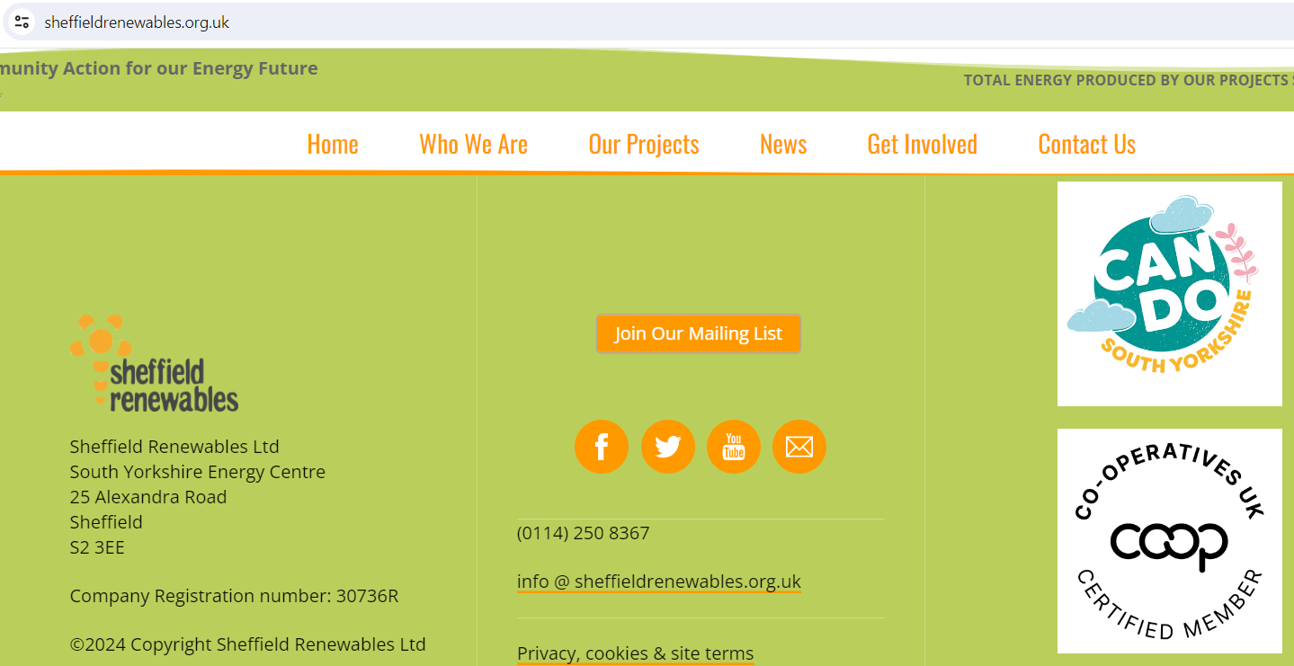
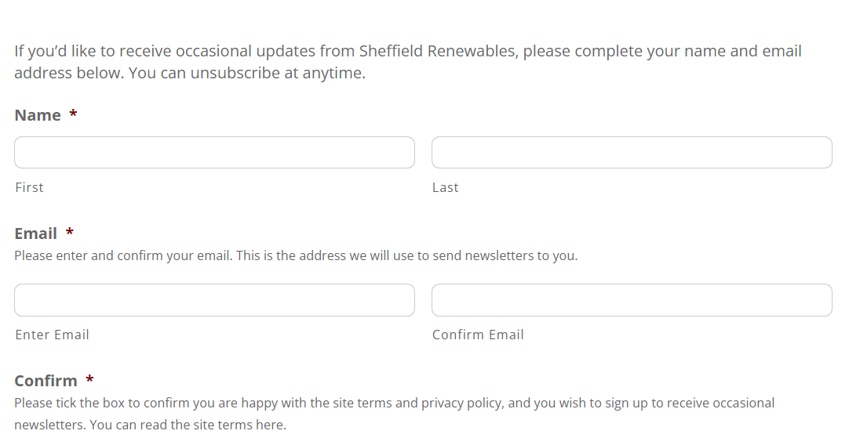
Newsletter: how to subscribe
Notes:
Whatsapp group?

Slide 47
Renewables
thank
you for attending !

